Slide 1
A Socio-Aware Decentralized Topology Construction Protocol
Stefanos Antaris*, Despina Stasi*, Mikael Högqvist†
George Pallis*, Marios Dikaiakos*
*University of Cyprus, †Hive Streaming AB
*{antaris.stefanos, despina.stasi, gpallis, mdd}@cs.ucy.ac.cy
†mikael@hivestreaming.com
Third IEEE Workshop on Hot Topics in Web Systems and Technologies
November 13th 2015

Slide 2
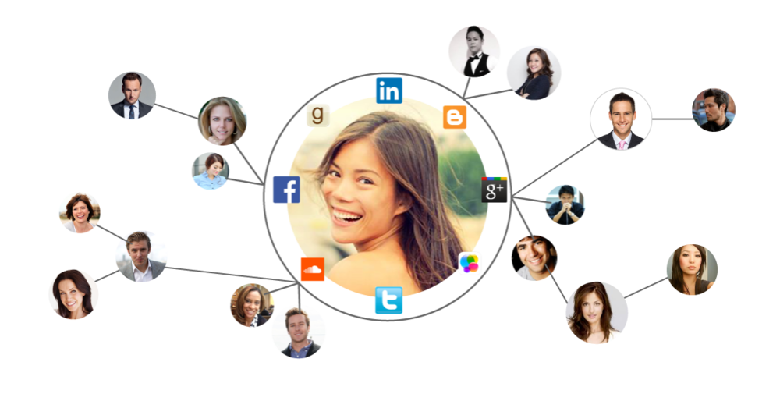




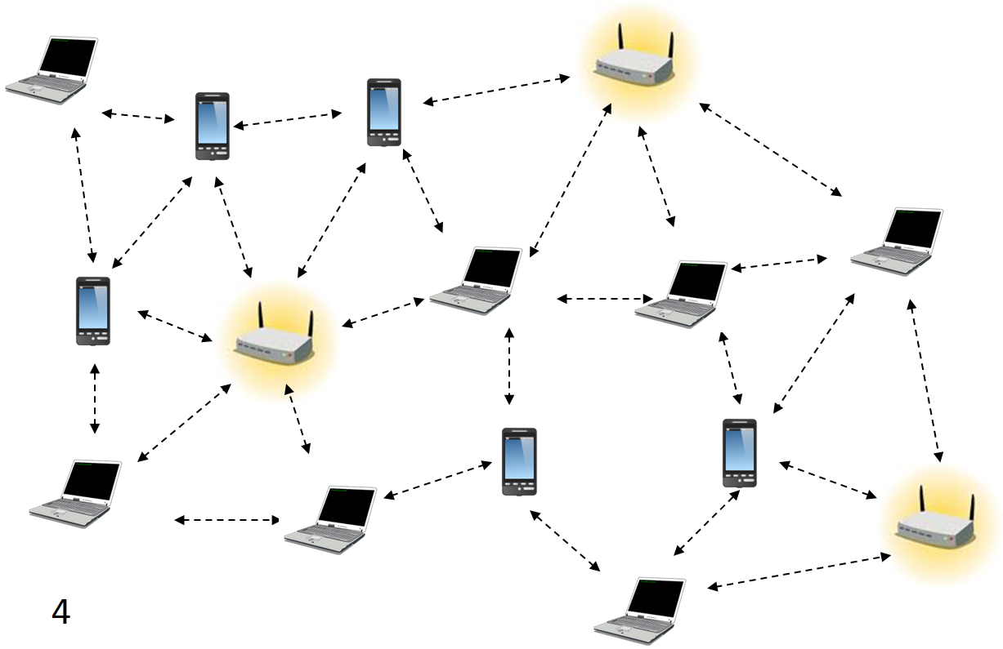


Introduction
  Ubiquitous communication platform
    Single server dependence
    Privacy issues
Social Network
  Decentralization
    Reliability
    Data ownership
    Topology inconsistency
    Additional number of hops
    Network latency
P2P Network

Slide 3
Research Question
“Is it possible to design a topology that incorporates the structural properties of the social network in order to reduce the number of hops and the network latency for a DOSN?”

Slide 4
Contribution
Design and implement a P2P Topology Construction Protocol
  Leverage the social graph for the P2P connections
Apply on a real-life NewsFeed service
Evaluate against state-of-the-art approaches
  75% number of hops reduction
  67% network latency reduction

Slide 5
Proposed Methodology
Each social user participates as a peer in P2P overlay network
Social Network
Peer State
NodeID 123
Social Neighbors IDs
112
134
101
P2P Network
Routing Table
214
102
…
114

Slide 6
Routing Table Construction
Similar to Pastry[1]
Why Pastry?
  Bounded number of TCP connections (N = 10⁹, B = 16, #TCP = 105)
  Logarithmic number of hops – prefix matching [2]
  Node failure-resilient
Routing Table of Peer with NodeId 123
012 | - | 212 | 314 | 420
103 | 114 | - | 132 | 142
120 | 121 | 121 | - | 124
No digits in common 123
First digit in common 123
Two digits in common 123
[1] A. I. T. Rowstron and P. Druschel, “Pastry: Scalable, decentralized object location, and routing for large-scale peer-to-peer systems”, Middleware’01 [2] C. G. Plaxton, et al., “Accessing nearby copies of replicated objects in a distributed environment,” IPDPS’09

Slide 7
Routing Table Characteristics
# peers eligible for a specific cell in the k^{th} row: N / B^{k+1}
  More options on the first rows
# social friends eligible for a specific cell in the k^{th} row: d / B^{k+1}
The probability that P2P connections overlap with the Social connections is
d / N
Routing Table of Peer with NodeId 123
012 | - | 212 | 314 | 420
103 | 114 | - | 132 | 142
120 | 121 | 121 | - | 124
No digits in common 123
First digit in common 123
Two digits in common 123

Slide 8


Social Friendship Request
Alice sends friend request to Bob
Step 1
Bob and Alice still needs logN hops to communicate
N=10⁶ , logN = 5
Social Network
Peer 112 looks up peer 123
Step 2
Bob accepts friend request
Step 3
P2P Network
Both update their Social Neighbors table
Step 4
Social Neighbors IDs
123
…
…
Social Neighbors IDs
112
…
…

Slide 9
NewsFeed Service
Alice identifies Social Neighbors’ Node IDs
Step 1
Social Neighbors IDs
123
334
…
Social Network
NewsFeed service requires
dlogN messages
N=10⁹ , logN = 7
d = 3000, # of messages = 21000
Alice sends message to Bob
Step 2
Alice sends message to Trudy
P2P Network
Step 3

Slide 10
Socially-aware Routing Table (1/3)
Desired properties
  Bounded number of TCP connections
  Maximize the direct connections between social friends
  Communication between non-social friends in logN hops
Bob’s Peer State
Routing Table of Peer with NodeId 123
012 | - | 212 | 314 | 420
103 | 114 | - | 132 | 142
120 | 121 | 121 | - | 124
Social Neighbors IDs
112
220
113
Can we augment the Social Neighbors IDs in the Routing Table?

Slide 11
Socially-aware Routing Table (2/3)
Step 1 : Periodically check for updates in Social Neighbors IDs table
Step 2 : New social friend is added
Step 3 : Identify appropriate position in Routing Table - Similar to Pastry
Step 4 : Replace previous connection
Bob’s Peer State
Routing Table of Peer with NodeId 123
012 | - | 212 | 314 | 420
103 | 114 | - | 132 | 142
120 | 121 | 121 | - | 124
Social Neighbors IDs
220
112
113
Conflict. Which one is the best candidate?

Slide 12
Socially-aware Routing Table (3/3)
Conflict solution
  Compare network latencies
  t(123,112) > t(123,113)
  Choose minimum
Achievements
  Biased flavor on the friends
  Reduce the data propagation latency
Bob’s Peer State
Routing Table of Peer with NodeId 123
012 | - | 212 | 314 | 420
103 | 114 | - | 132 | 142
120 | 121 | 121 | - | 124
Social Neighbors IDs
220
112
113

Slide 13
Evaluation
Data Set | Users | Connections | Average Degree
Facebook [1] | 63,731 | 817,090 | 25.642
Twitter [2] | 456,631 | 14,855,874 | 32.533
Slashdot [2] | 82,168 | 948,463 | 11.543
Epinions [2] | 75,879 | 508,837 | 6.706
NewsFeed simulation:
Data generation rate: exponential distribution [3]
Information diffusion: users propagate their posts to their social friends independently
Simulation parameters:
Data Sets with different characteristics
Node registration rate: exponential distribution [3]
Number of trials: 100 independent simulations
Discrete event simulator: FreePastry 2.1
[1] B. Viswanath, et al., “On the evolution of user interaction in facebook”, WOSN, 2009
[2] Stanford large network dataset collection”, http://snap.stanford.edu, accessed Jul. 02, 2015
^{[3]} K. Zhu, et al., “Modelling population growth in online social networks”, Complex Adaptive Modelling, 2013

Slide 14
Evaluation
Data Set | Users | Connections | Average Degree
Facebook [1] | 63,731 | 817,090 | 25.642
Twitter [2] | 456,631 | 14,855,874 | 32.533
Slashdot [2] | 82,168 | 948,463 | 11.543
Epinions [2] | 75,879 | 508,837 | 6.706
Evaluation metrics used:
Number of Hops: The P2P hops required to communicate two social friends
Network Latency: The time spent to propagate a message
% of social connections: The social connections coverage
State-Of-The-Art comparison:
Pastry: No social friendship augmentation
SPROUT [3]: Chord overlay network with additional social connections
[1] B. Viswanath, et al., “On the evolution of user interaction in facebook”, WOSN, 2009
[2] Stanford large network dataset collection”, http://snap.stanford.edu, accessed Jul. 02, 2015
[3] S. Marti, P. Ganesan, and H. Garcia-Molina, “DHT routing using social links”, P2P, 2004

Slide 15
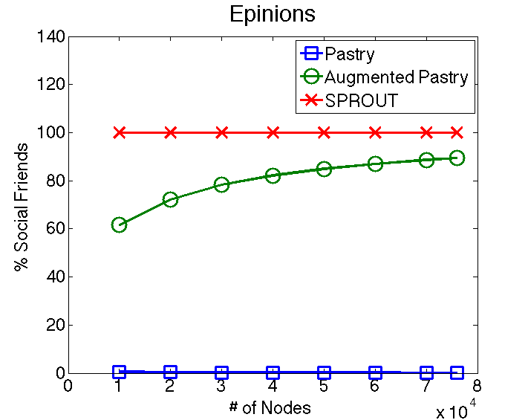
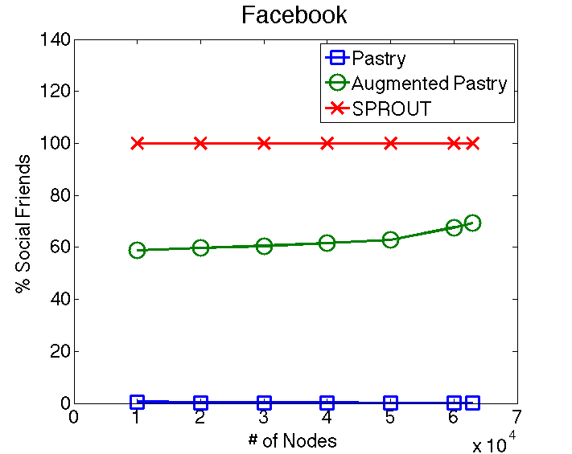
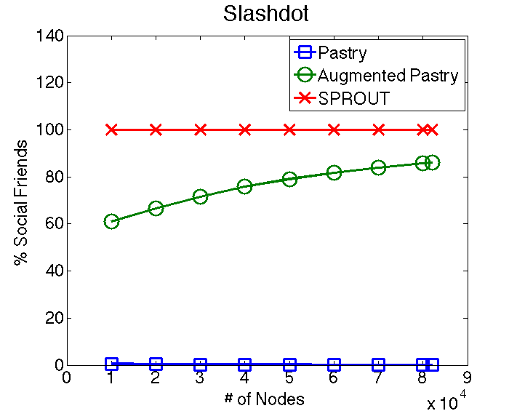
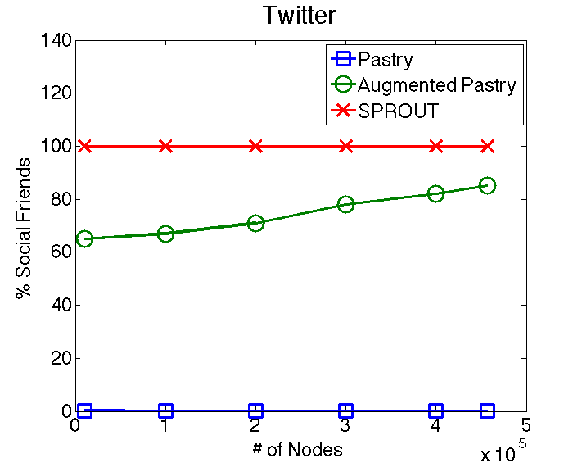
Percentage of Social Connections
More than 60% of social friends are included in the routing table.
Social friendship coverage increases as the network grows
  Routing Table Size
SPROUT achieves better results
  Direct connections to all of the social user’s neighborhood set.
  Unrealistic for real-life social networks
Av. Degree: 6.706
Nodes: 75,879
Av. Degree: 25.642
Nodes: 63,731
Av. Degree: 11.543
Nodes: 82,168
Av. Degree 32.533
Nodes: 456,631

Slide 16
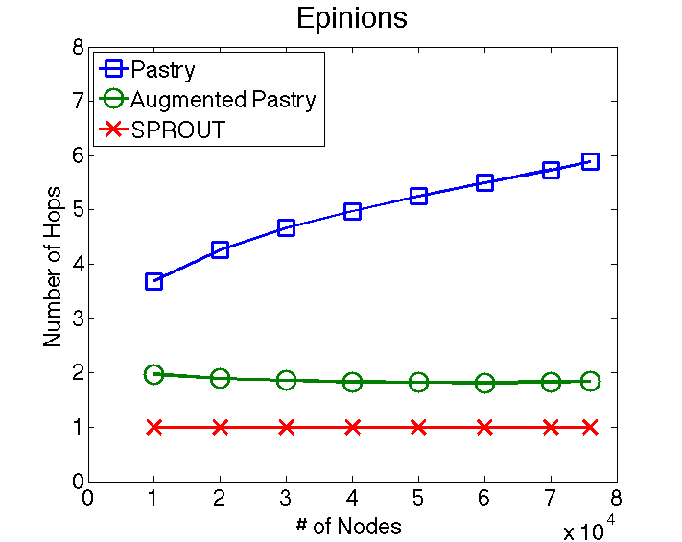
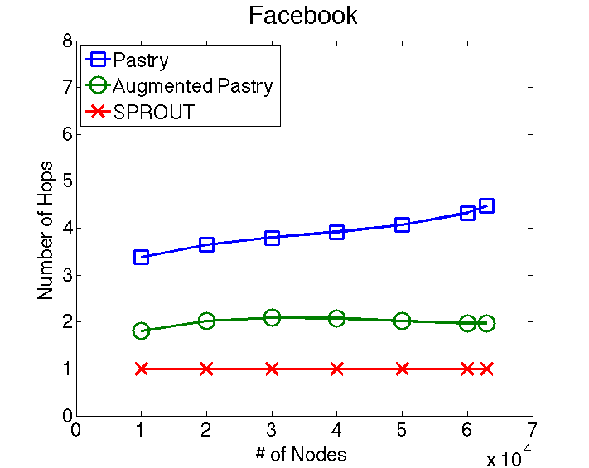
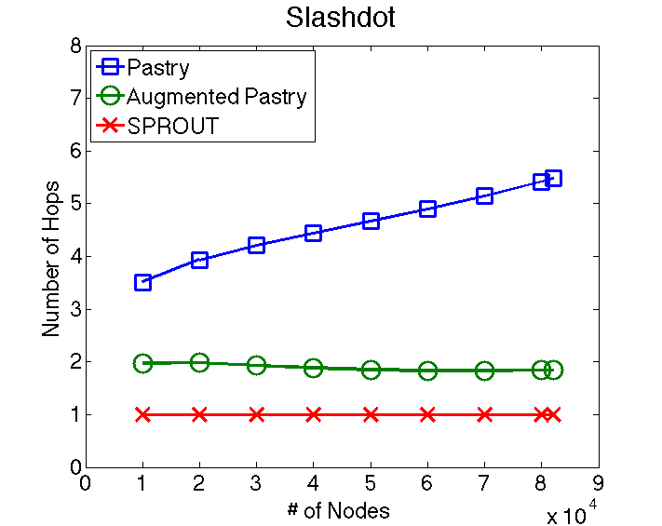
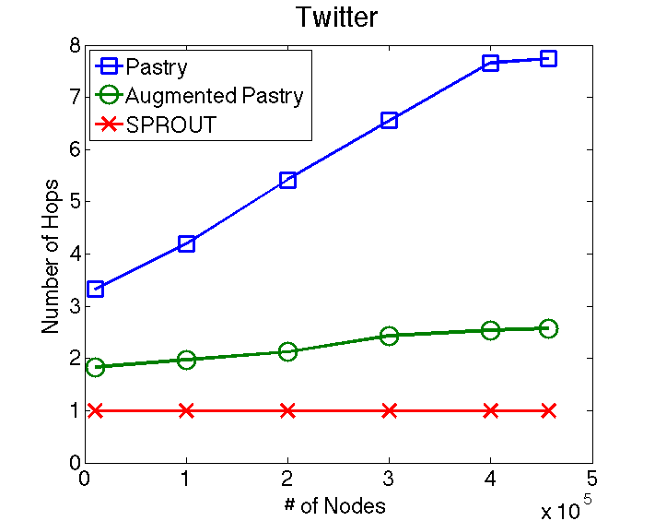
Number of Hops
75% hops reduction in all Data Sets
Hops are not increasing logarithmically as the network grows

Slide 17
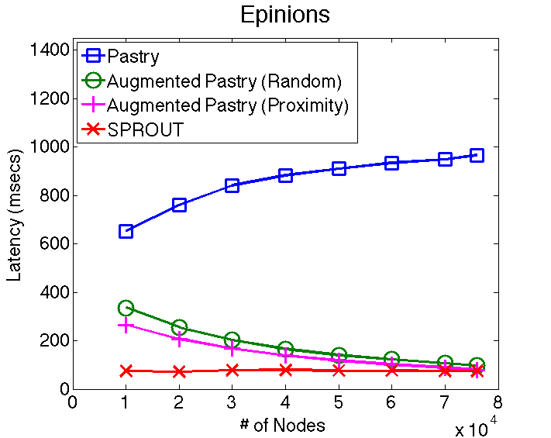
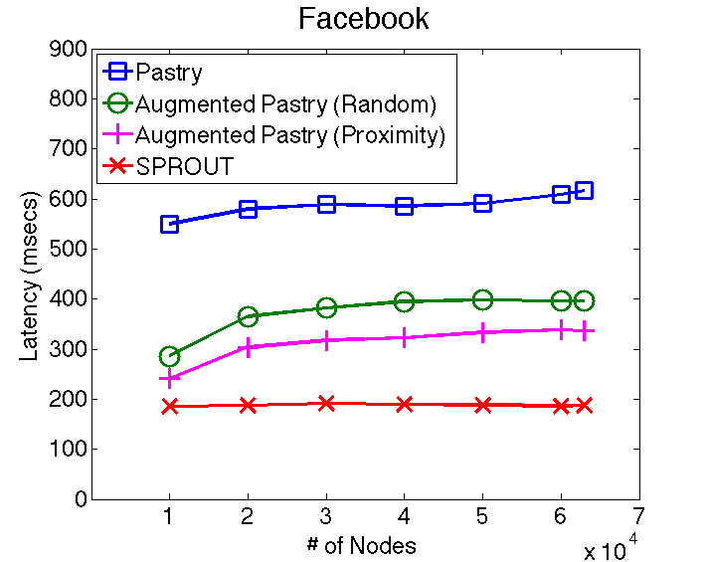
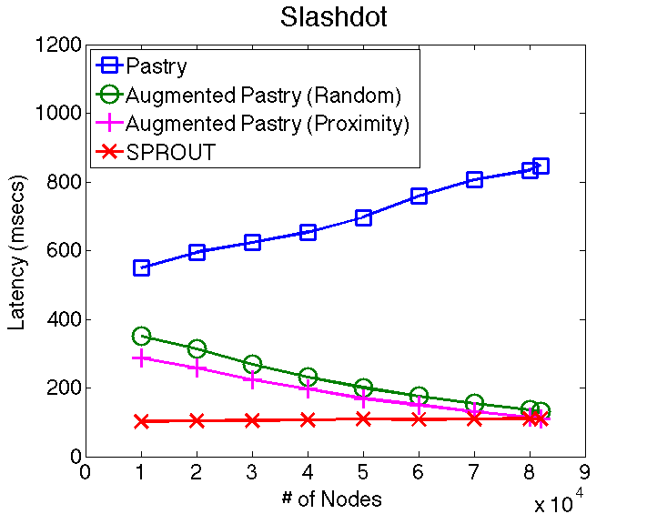
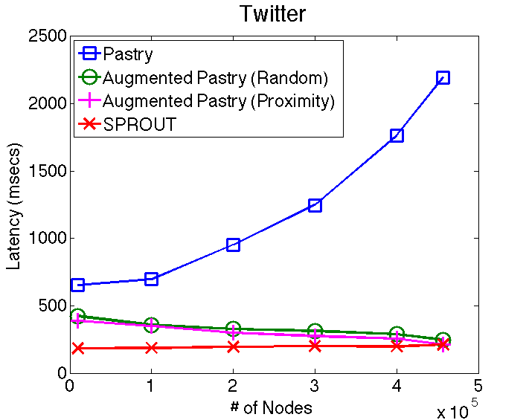
Network Latency
67% network latency reduction
SPROUT
  Depends on the connectivity between social friends.

Slide 18
Conclusions
Socially-aware P2P overlay network
  Bounded number of P2P connections
  60% more socially-connected peers
  Random lookups in hops
NewsFeed service
  Information propagation with 75% less hops
  Network latency reduced by 67%
Future research questions
  Biased Node ID assignment?
  Routing using social network subgraph?
  Social users interactions?

Slide 19


Acknowledgements
isocial-itn.eu
co-funded by the European Commission
Notes:
Present the acknowledgments

Slide 20


antaris.stefanos@cs.ucy.ac.cy http://cs.ucy.ac.cy/~santar01
Thank
you!
Laboratory for Internet Computing
Department of Computer Science
University of Cyprus
http://linc.ucy.ac.cy
Notes:
Thank you.

